Slide 1
Group 4
Data Science Salaries

Slide 2
Team Members
Stanley Yanis - Question 1
Brianna Joseph - Question 2
Jonathan Murphy - Question 3
Joe Haas - Question 4

Slide 3
Purpose of Analysis
With this DataSet we hope to shed valuable insight for any new or current individuals looking for work in the Data Analytics/Science , Machine Learning, or AI fields. We hope to help better inform individuals of both the potential career opportunities out there and the current value of their skill sets / level of experience.

Slide 4
Question 1
Salary Distribution Among Data Science Professionals

Slide 5
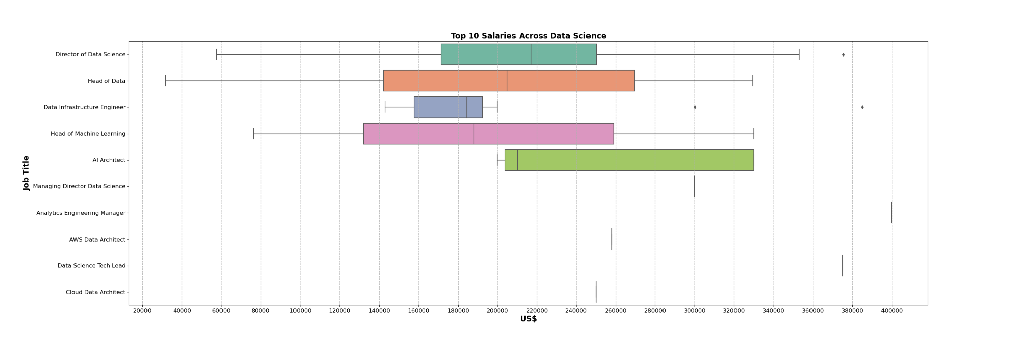
Distribution among Top 10

Slide 6
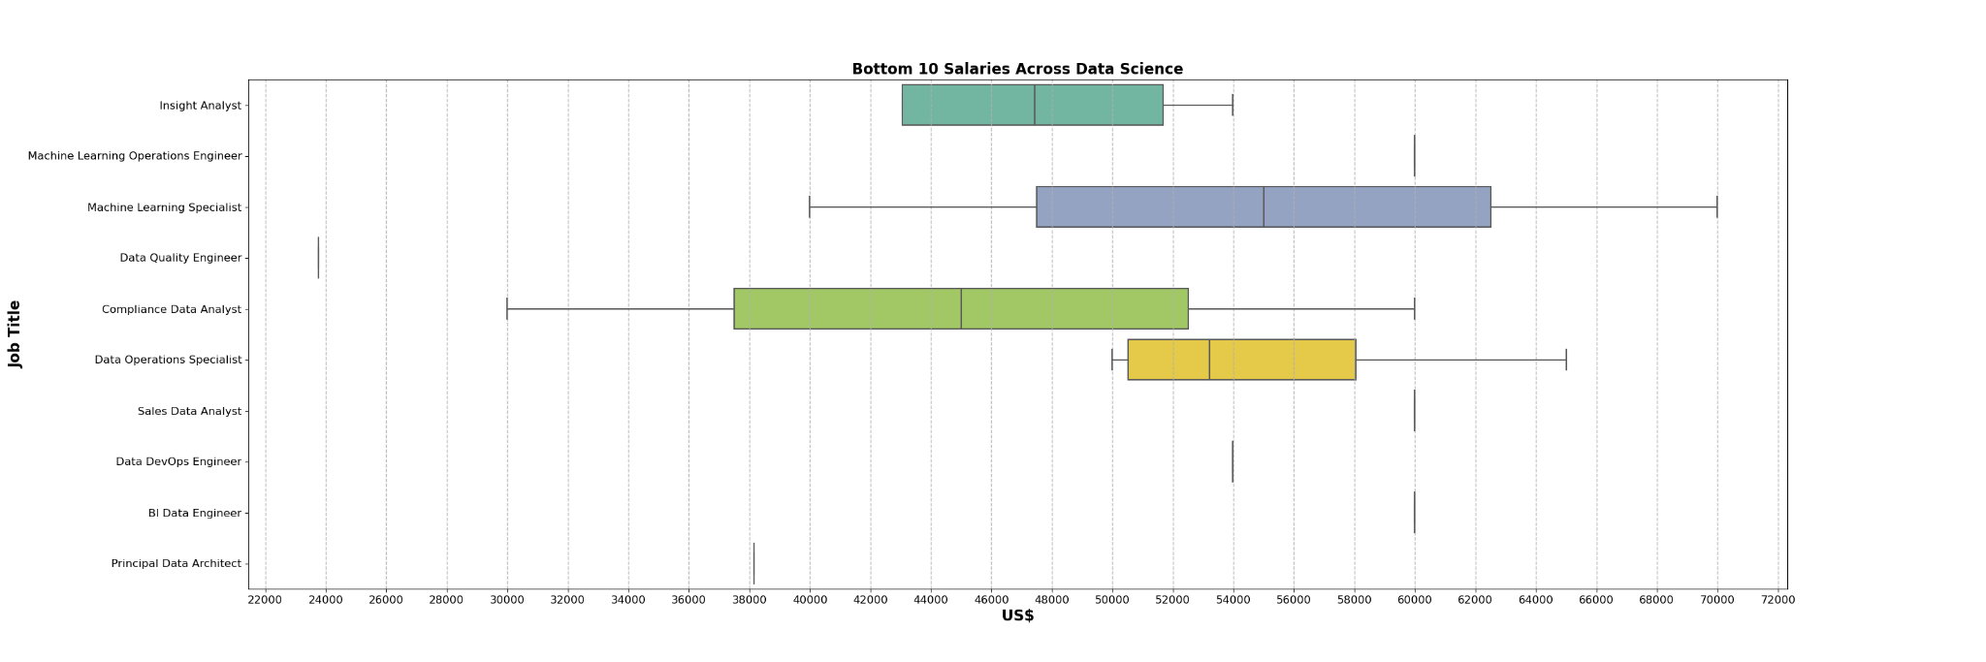
Distribution of Bottom 10

Slide 7
Question 2
Comparison of Median Salaries Across Different Job Titles

Slide 8
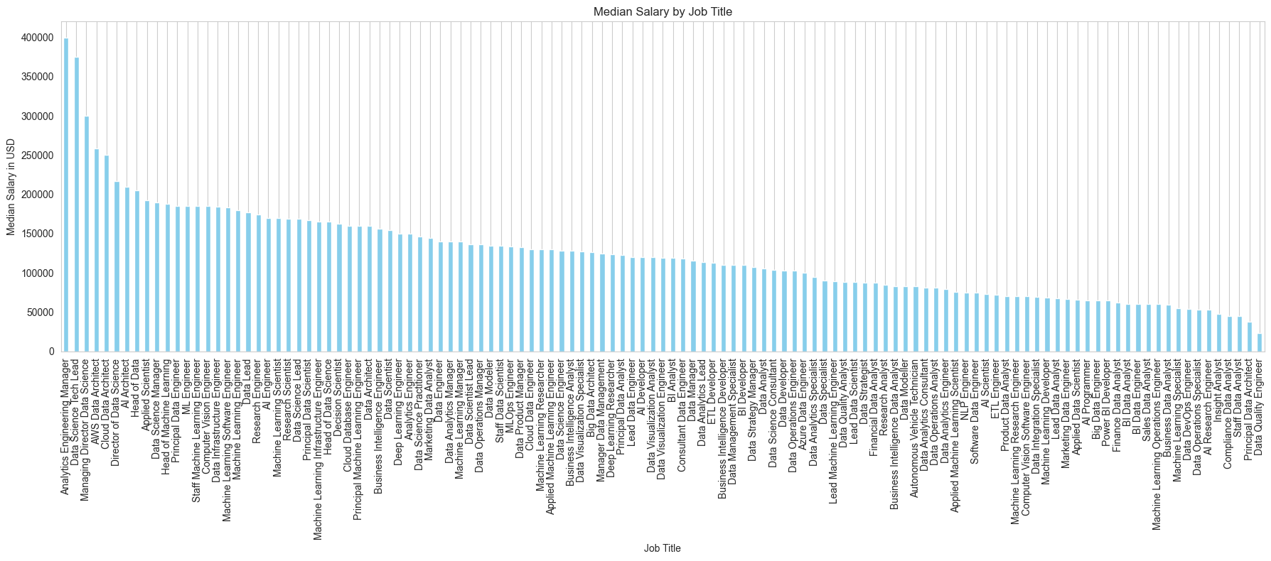
Direct Comparison: Each bar represents the median salary for a specific data science role, making it easy to compare these medians at a glance. Taller bars indicate higher salaries, offering a visual hierarchy of compensation across roles.
Clarity and Simplicity: The simplicity of a bar chart — with one axis representing the roles and the other the salaries — allows for quick interpretation, making it accessible even to those unfamiliar with data analysis.
Consistency and Uniformity: Using a bar chart ensures that each role is given equal weight in the visualization, with differences in salary highlighted by the length of the bars rather than any variations in box size or shape, as seen in box plots.
Absolute Values: While box plots are excellent for showing distribution and spread, bar charts focus on the absolute median values, which can be more intuitive when the goal is to compare specific salary figures rather than overall salary distributions.
Median Salaries within their own Data Science Roles & compared to the others

Slide 9
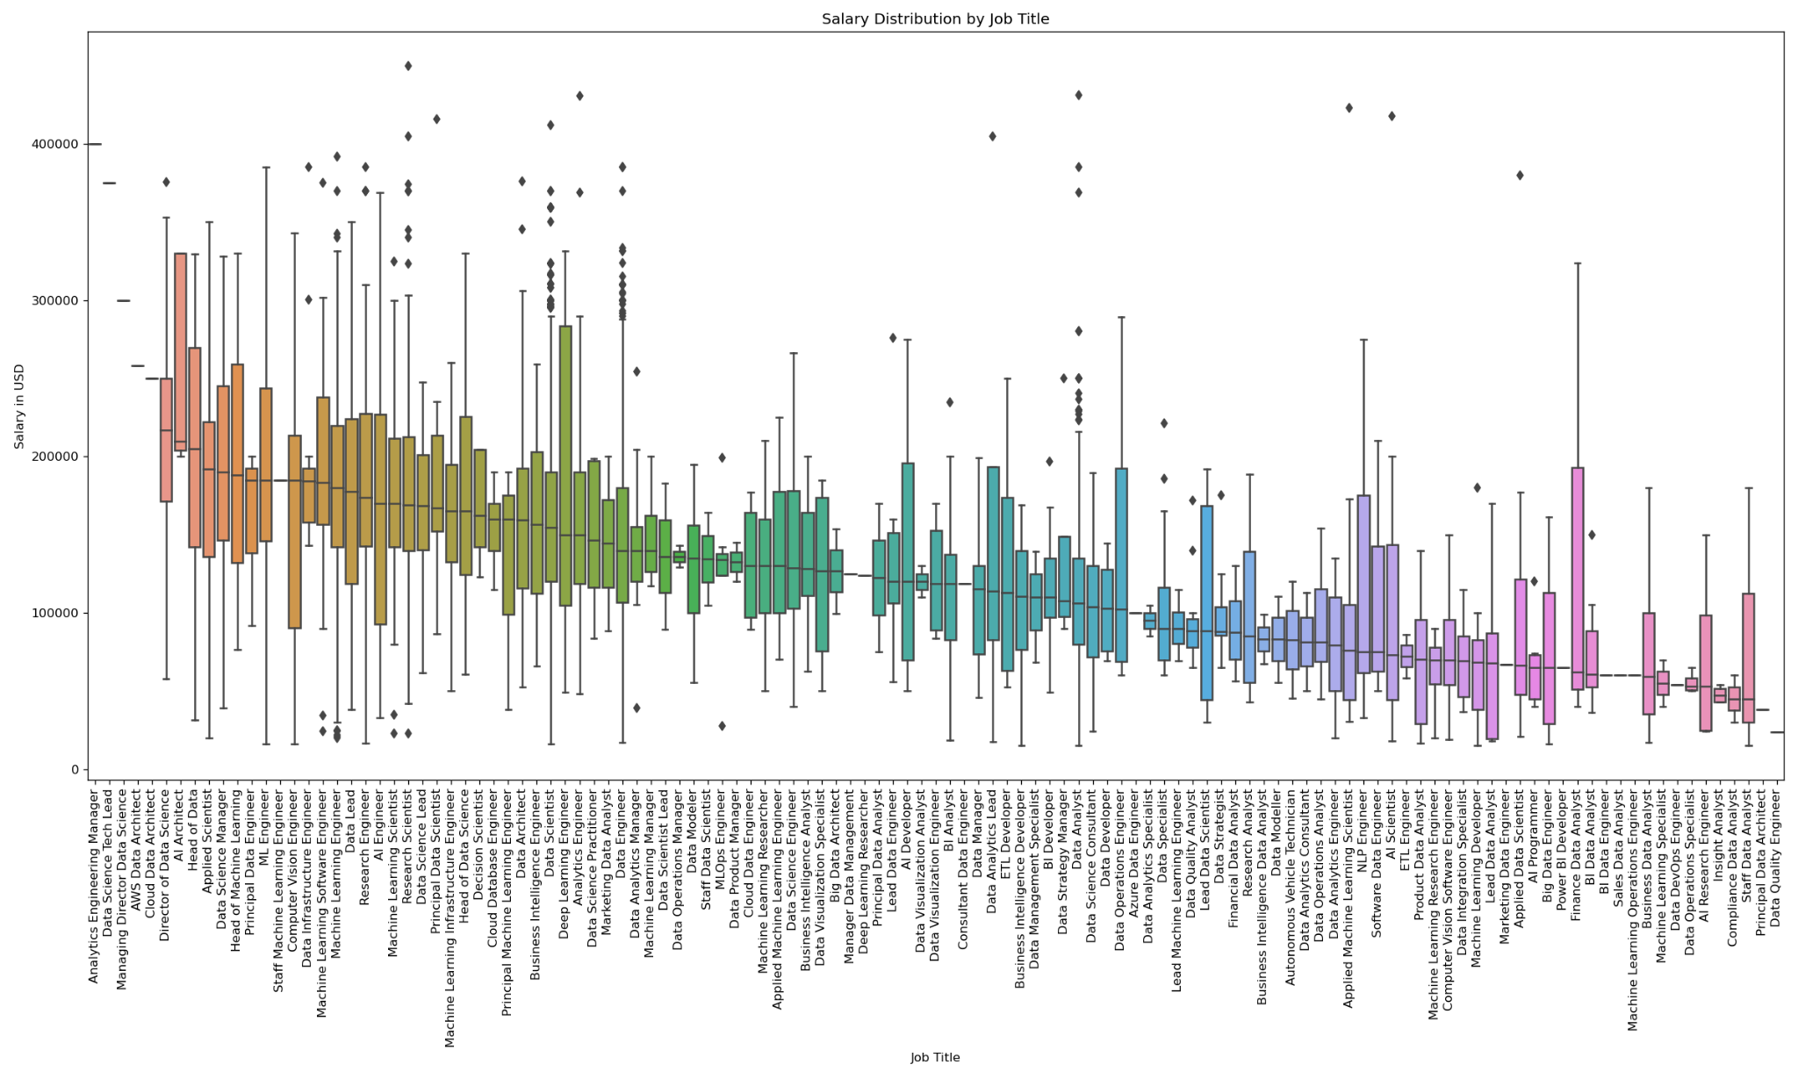
Median Representation: The central line in the box represents the median salary of each role, providing a clear visual indicator of the central tendency without being influenced by outliers.
Variability and Spread: The length of the box shows the interquartile range (IQR), which indicates the spread of the middle 50% of salaries. A longer box means more variability in salary within that role.
Comparisons: By aligning boxes for different job titles along a common scale, it's easy to compare the median salaries across roles, as well as the spread and general distribution of salaries.
Outliers: Any data points that appear outside of the whiskers (the lines extending from the top and bottom of the box) can be considered outliers. These points represent salaries that are significantly higher or lower than the norm for that role.
Comparison of Median Salaries using box plot

Slide 10
Analysis
The Salary Distribution Analysis of the dataset, encompassing 8,113 salary entries, presents a vivid picture of the salary trends in the data field. The median salary, the midpoint of the data, stands at $142,200 USD, suggesting that the salaries are relatively evenly distributed across the dataset. The Interquartile Range (IQR) — the middle 50% of the salary data — stretches across $80,900 USD, from the 25th percentile at $105,000 USD to the 75th percentile at $185,900 USD, reflecting the core salary band. Interestingly, the analysis identifies the upper threshold for potential outliers at $307,250 USD, beyond which 147 entries are classified as outliers, indicating salaries that are significantly higher than typical. These outliers may represent positions with extraordinary demands, specialized skills, or possibly anomalies within the data.

Slide 11
Question 3
Salary Trends Based on Geographic Location

Slide 12
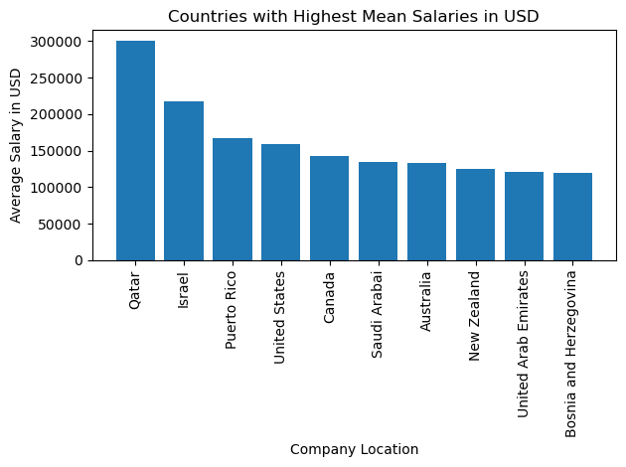
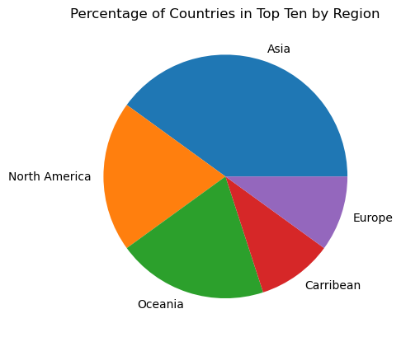
Top Ten Countries with Highest Mean Salaries

Slide 13
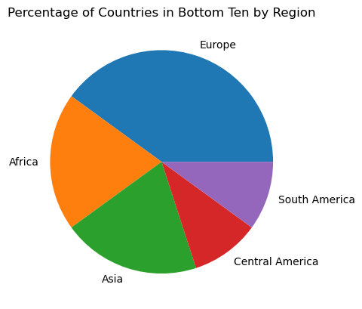
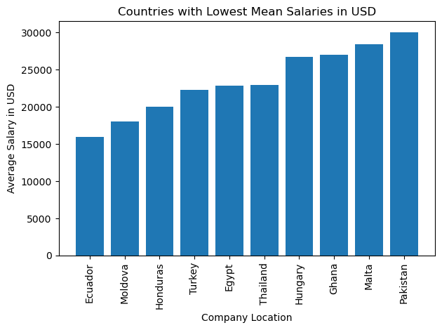
Top Ten Countries with Lowest Mean Salaries

Slide 14
Analysis
There is a very large disparity between the minimum and maximum salaries measured in USD. The lowest is Ecuador's average salary of $16,000, while the highest average salary belongs to Qatar at $300,000, almost 20 times as large.
However, there does not appear to be a significant correlation between the region of the company and the average salary. The range of salaries is wide across all regions, suggesting that there is no strong correlation between geographic location and salary trends in data science professions.

Slide 15
Question 4
The Impact of Experience on Salary

Slide 16
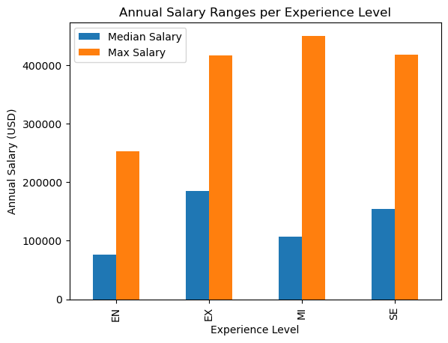
The impact of Experience on Salary at a glance
When taking a look at the Data provided the spread of the median salary per level of experience is as most people would expect, You see a significant increase per level of experience, the same follows on average for the Max salary ranges.
(EN) Entry / Junior level - ~$76,400
(MI) Mid-level / Intermediate - ~$106,500
(SE) Senior-level / Expert - ~$154,470
(EX) Executive / Director - ~$185,000

Slide 17
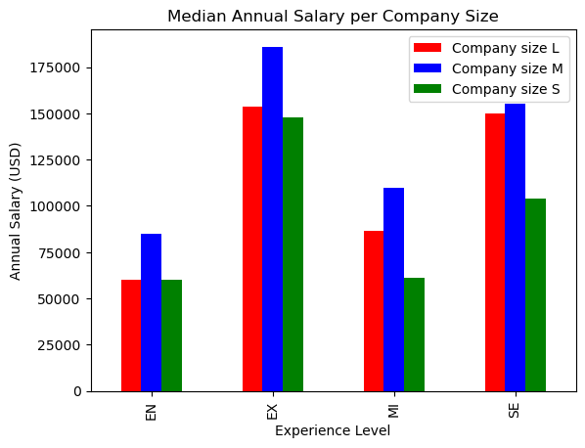
Taking a Deeper look at Median Salary ranges when compared to the size of the Company
When accounting for the size of the company the median salary per experience level does not have a linear increase from one level to the next as in the previous slide. According to the data companies classified as Medium (M) with between 50 to 250 employees on average pay higher median wages across all experience levels vs. Small (S) and Large (L) companies.

